Slide 1
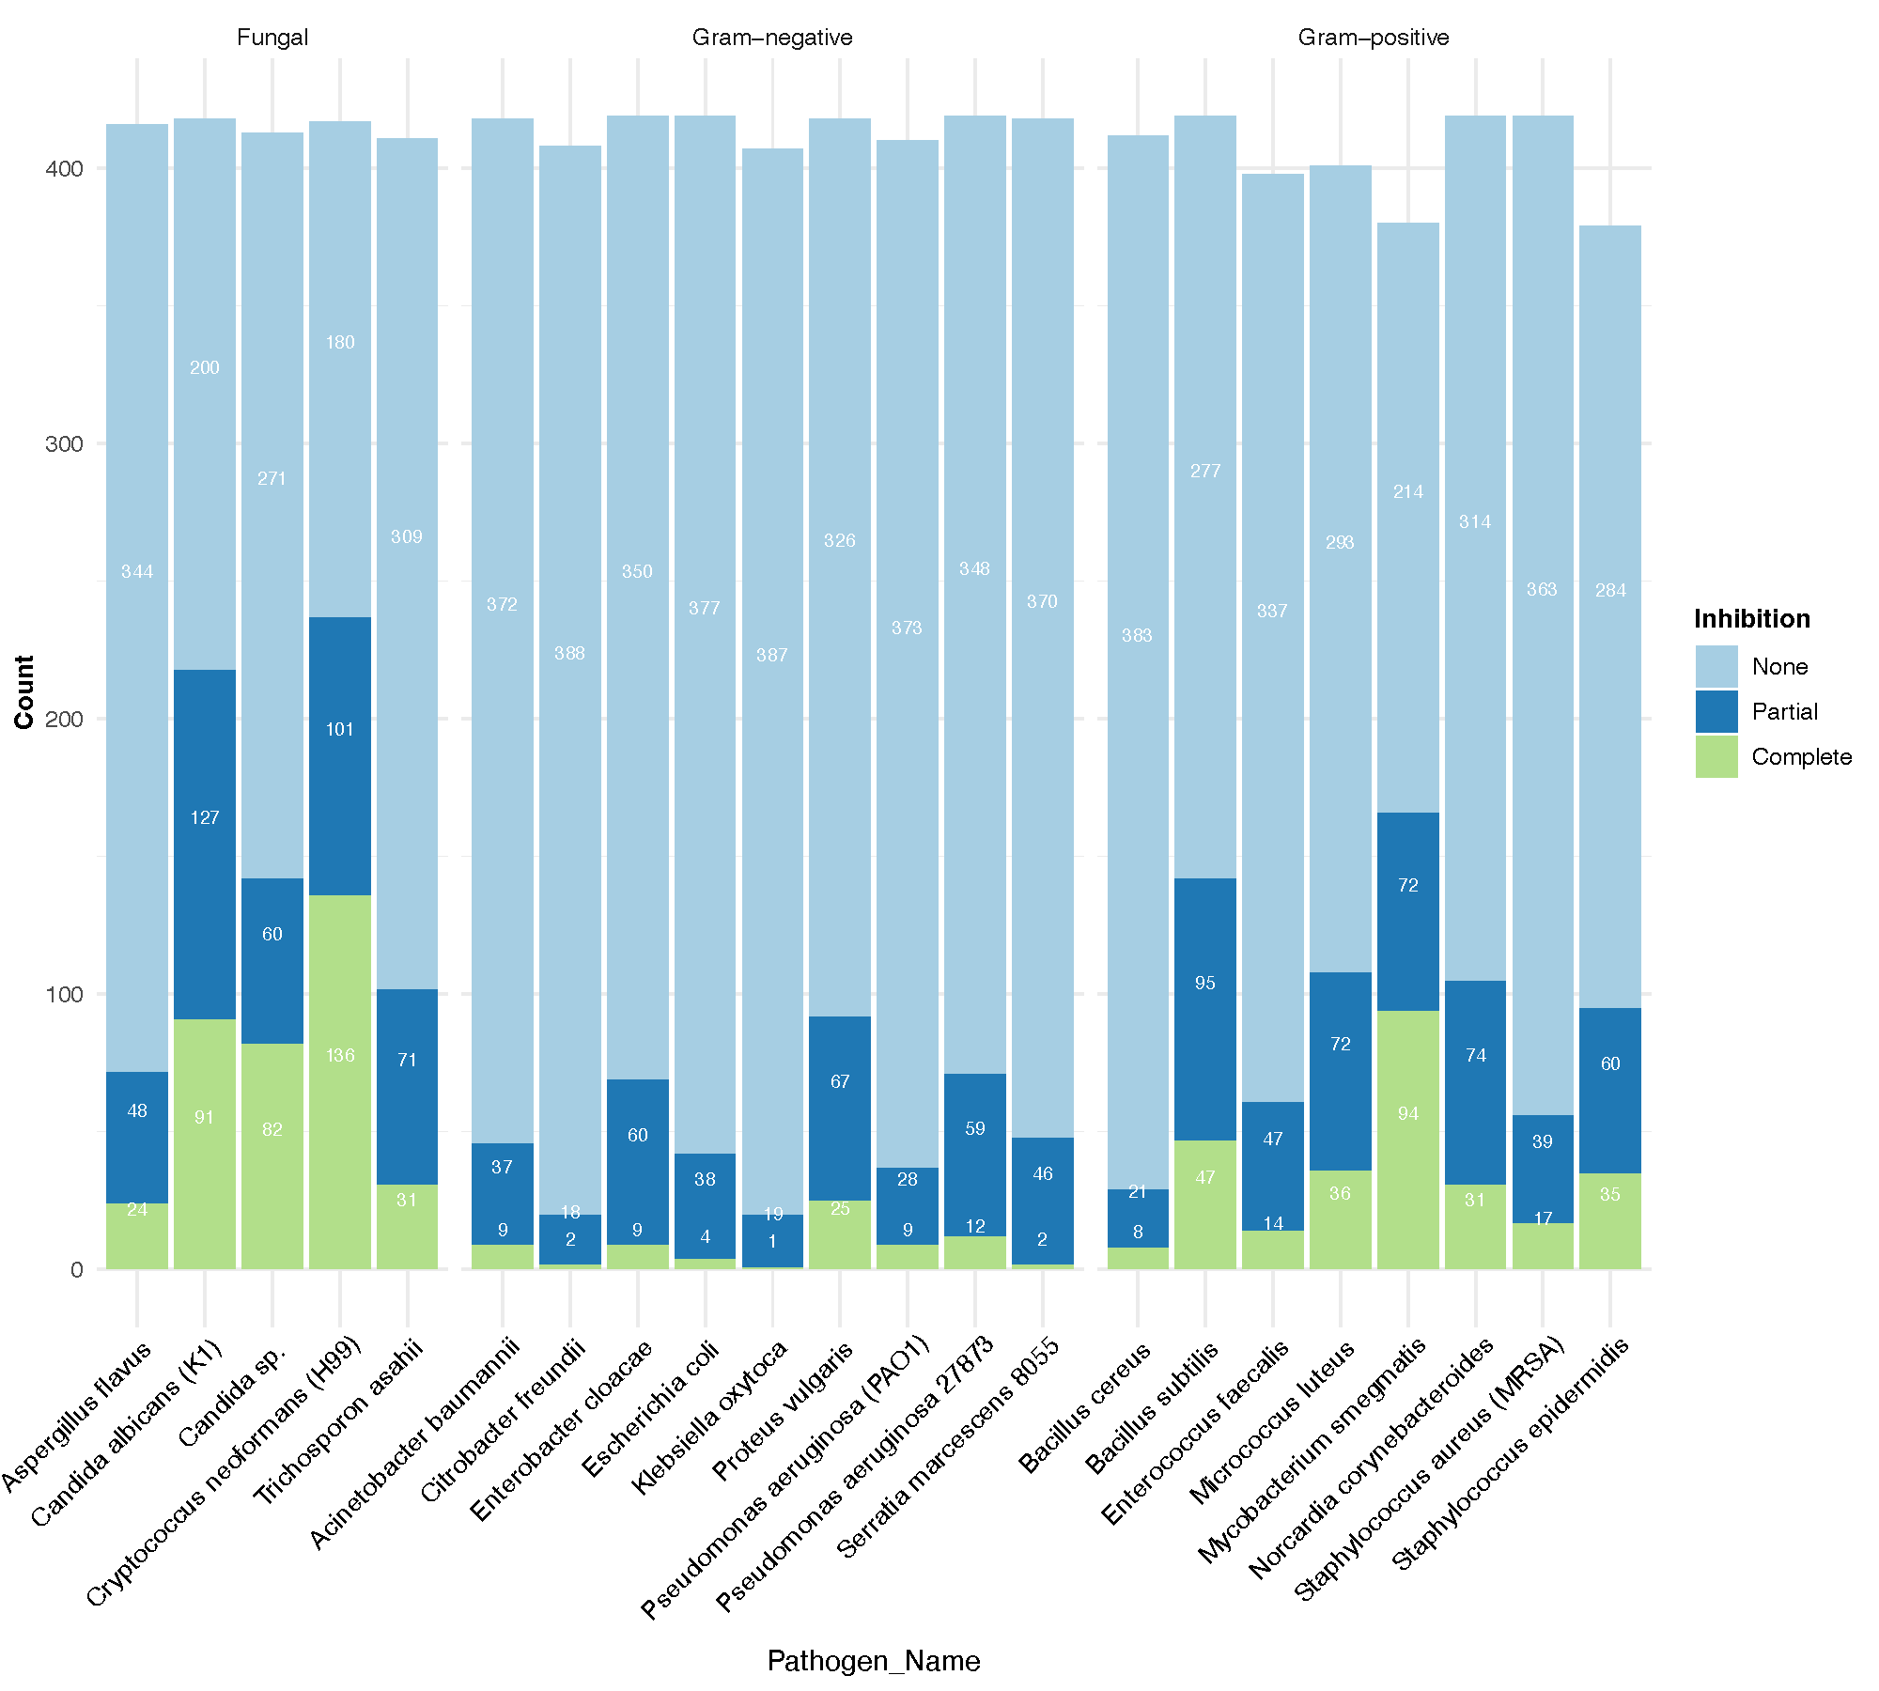
A
C
B
Figure 3: Bacteria from the human skin exhibit specific and broad antifungal activity. A) Hierarchical clustering of pairwise interactions where skin bacteria are tested against a panel of pathogens. Growth patters of pathogens are scored from 1 (no inhibition) to 4 (complete or full inhibition). Rows are individual skin bacteria annotated by body sites and genus. Columns are pathogens grouped by Gram-positive, Gram-negative, and fungal pathogens. B) Quantification of inhibition (none, partial, and complete) profiles. Y-axis is number of strains and x-axis is pathogen panel. C) Strains with zone of inhibition and full inhibition against fungi are grouped by different combinations of antifungal activity.

Slide 2
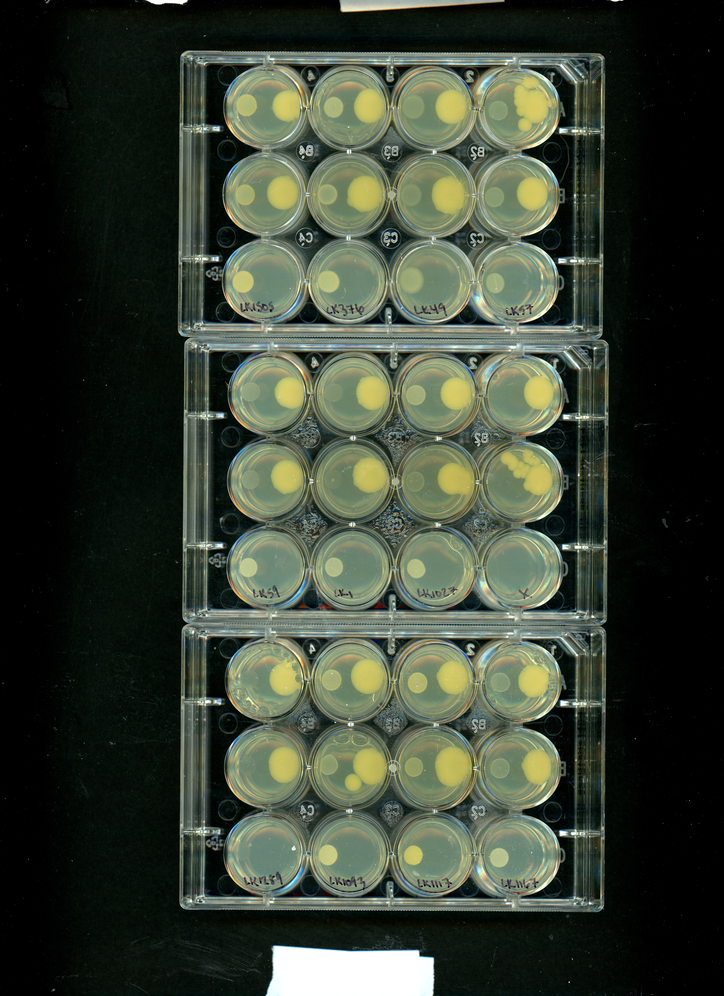
A
C
D
B
Complete
Partial
None

Slide 3
A
B
C
Figure 3: Bacteria from the human skin exhibit specific and broad antifungal activity. A) Hierarchical clustering of pairwise interactions where skin bacteria are tested against a panel of pathogens. Growth patters of pathogens are scored from 1 (no inhibition) to 4 (complete or full inhibition). Rows are individual skin bacteria annotated by body sites and genus. Columns are pathogens grouped by Gram-positive, Gram-negative, and fungal pathogens. B) Quantification of inhibition (none, partial, and complete) profiles. Y-axis is number of strains and x-axis is pathogen panel.

